Slide 1
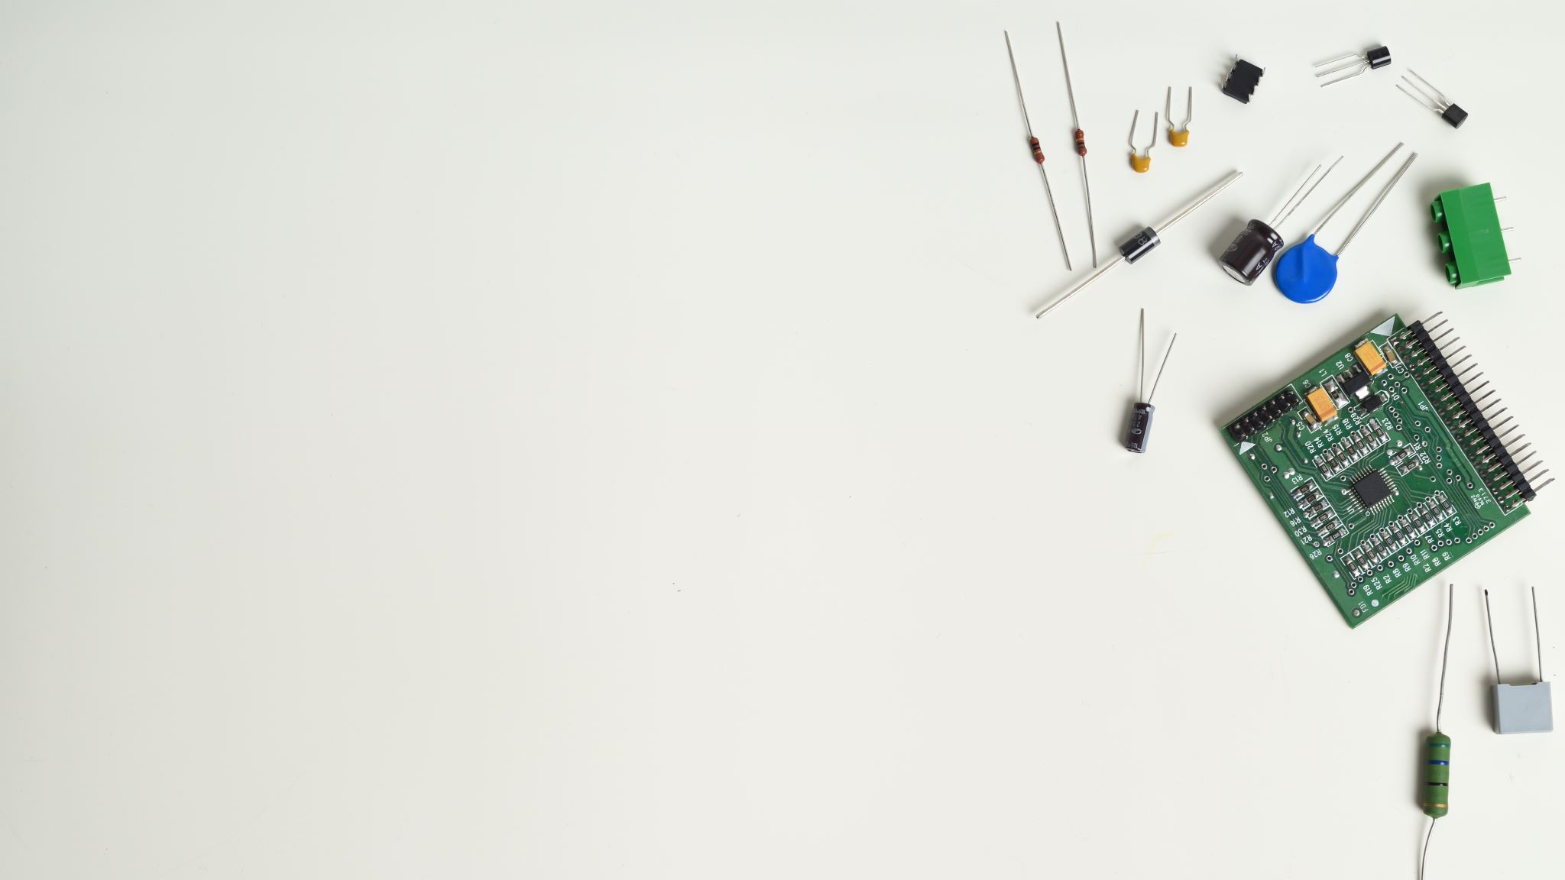
Testing Hardware Components
JASMEET SINGH(C0751797)
GROUP #2

Slide 2
CONTENT
BLOCK DIAGRAM OF PROJECT
COMPONENTS TO BE TESTED
WHAT IS HARDWARE TESTING ??
HARDWARE REQUIREMENTS FOR TESTING
SOFTWARE REQUIREMENT FOR TESTING
INTRODUCTION AND TESTING
FINGERPRINT SENSOR
BUZZER
RTC
TOUCHSCREEN
ESP32 CAM
REFERENCES

Slide 3
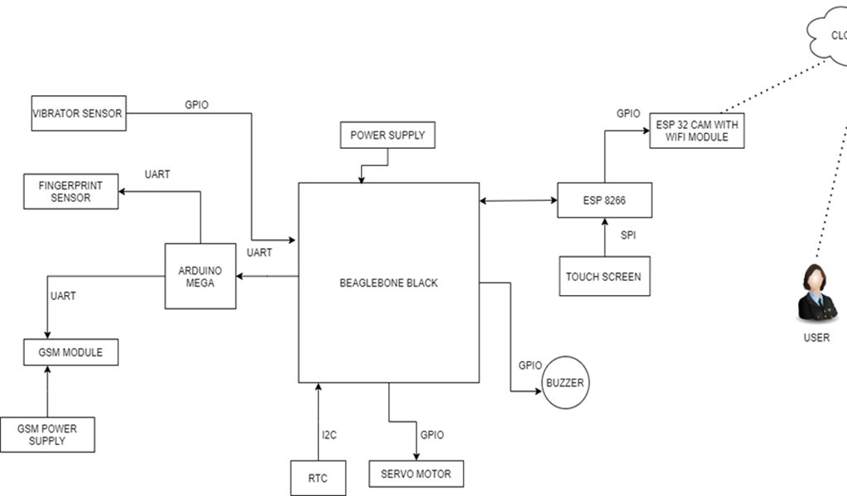
BLOCK DIAGRAM OF PROJECT

Slide 4

COMPONENTS TO BE TESTED
Fingerprint Sensor
Real time Clock
ESP32 CAM Module
Touchscreen
Buzzer

Slide 5

WHAT IS HARDWARE TESTING ??
In testing, we need to check the device whether it work properly or provide suitable voltage or current to run the components to make sure it would not damage the circuit
In case any of the component would not working we might have to buy new one after troubleshooting has been done
In order to check the components, we use Arduino UNO and some of the example code that already exist to make it simpler

Slide 6
HARDWARE REQUIREMENTS FOR TESTING
Arduino UNO
Arduino Mega
Fingerprint Sensor
Real time Clock
ESP32 CAM Module
Touchscreen
Breadboard
Buzzer
Jumping wires
Resistor/Capacitor Kit

Slide 7
SOFTWARE REQUIREMENT FOR TESTING
Arduino IDE software used to build code for every component to check whether the component is working properly or not.
The Arduino Integrated Development Environment - or Arduino Software (IDE) - contains a text editor for writing code, a message area, a text console, a toolbar with buttons for common functions and a series of menus. It connects to the Arduino hardware to upload programs and communicate with them.

Slide 8
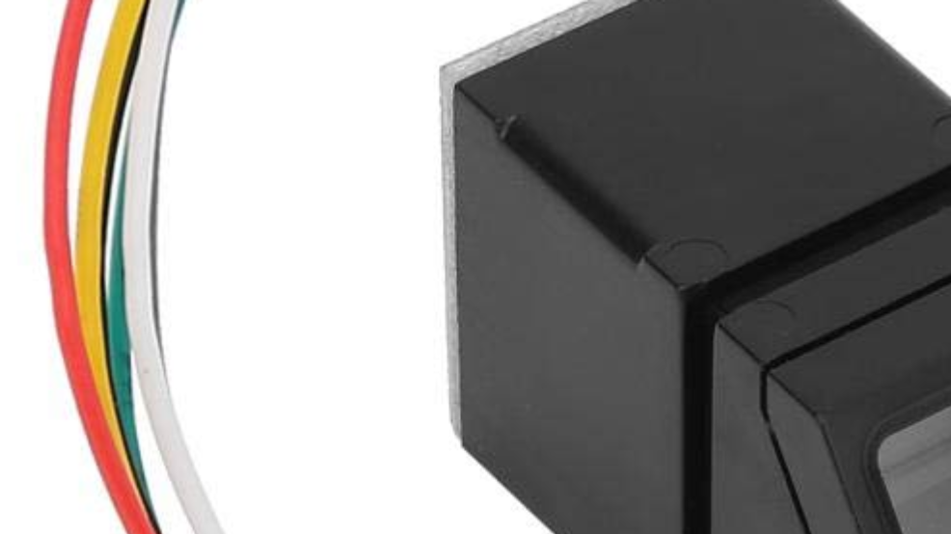
INTRODUCTION TO FINGERPRINT SENSOR
The R307 Optical Fingerprint Module integrates fingerprint algorithm chip with functions such as fingerprint entry, image processing, feature extraction, template generation, template storage, fingerprint comparison (1:1) and fingerprint search (1:N).
Fingerprint reader can conduct secondary development and can be embedded into various end products such as: access control, attendance, safety deposit box, car door locks.
Low power consumption, low cost, small size, excellent performance.
Professional optical technology, precise module manufacturing technic.
Good image processing capability, can successfully capture image up to resolution 500 DPI.

Slide 9
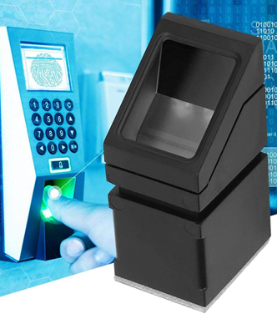
INTRODUCTION TO FINGERPRINT SENSOR
The chip has an Ultra-thin optic sensor and SmackFinger 3.0 fingerprint algorithm.
High-speed and accurate fingerprint recognizing technology
Communication may take place through UART or USB interface.
It can Read/Write templates from/to the device.

Slide 10
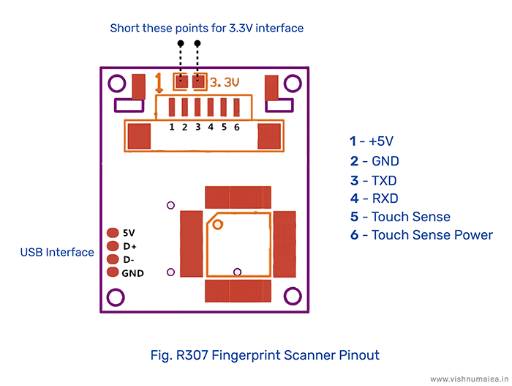
PIN DESCRIPTION OF FINGERPRINT SENSOR

Slide 11
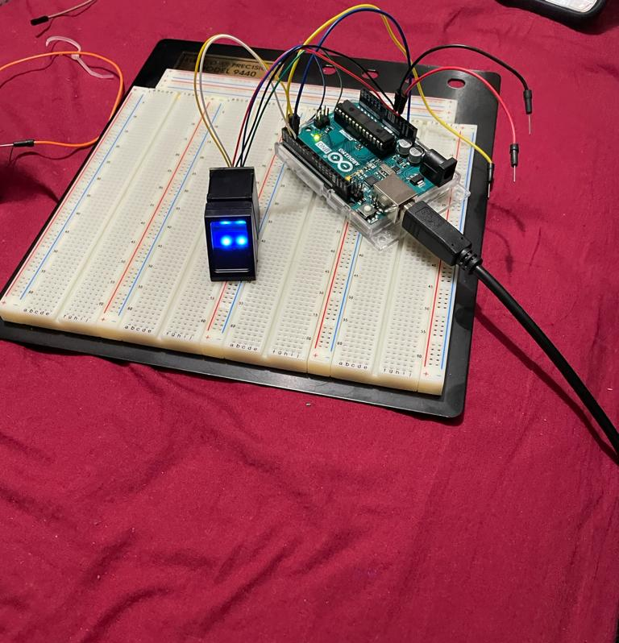
HOW TO TEST FINGERPRINT SENSOR ??
Fingerprint sensor is tested using Arduino UNO.
It requires breadboard, Arduino UNO, Fingerprint Sensor, and jumping wires.
Connect the Red wire(+5V) to the 5V of Arduino UNO.
Connect the black wire(GND) to the GND of Arduino.
Connect the Yellow wire(Tx) to the Pin 2 of Arduino.
Connect the White wire(Rx) to the Pin 3 of Arduino.

Slide 12
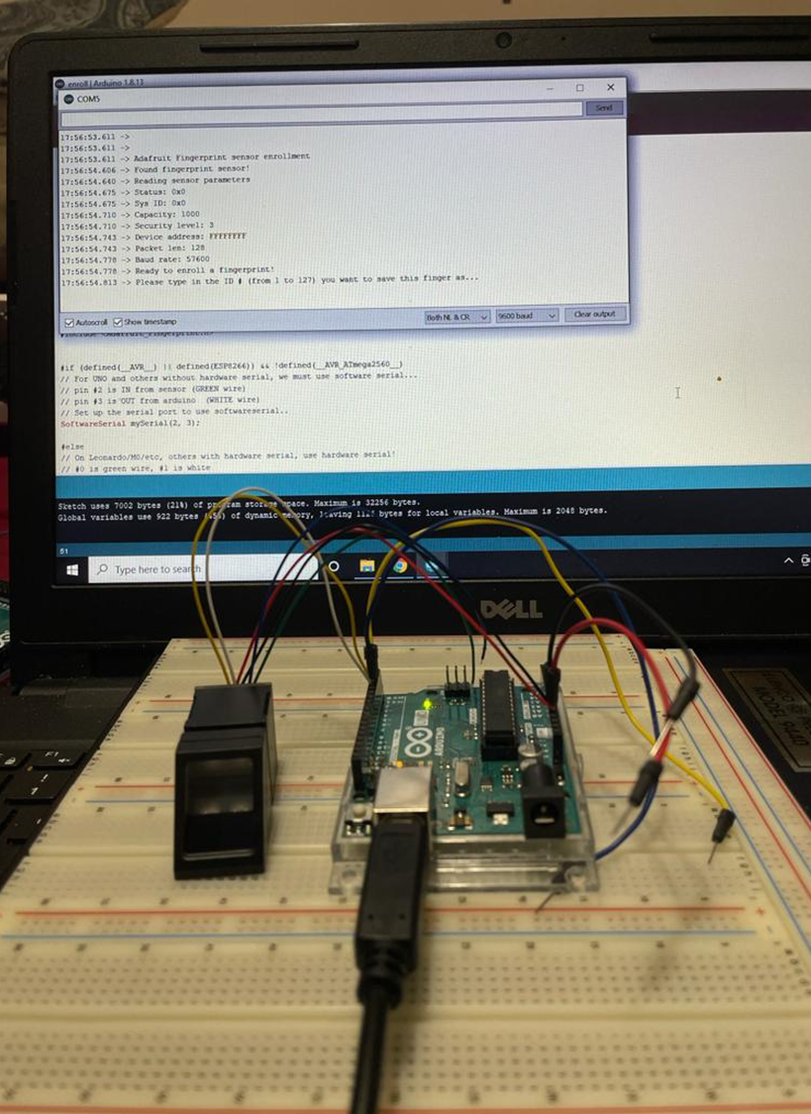
TESTING ON ARDUINO IDE
For Further Steps we need Arduino IDE.
To add Fingerprint library we have to follow the steps given below:
File > Example > Adafruit Fingerprint Sensor Library > Fingerprint
To add board the following steps are made:
Tools > Board > “Arduino UNO”
The last step is to save and execute the code.
Finally, the result is displayed at COM3: “Adafruit Finger detect test found.”

Slide 13
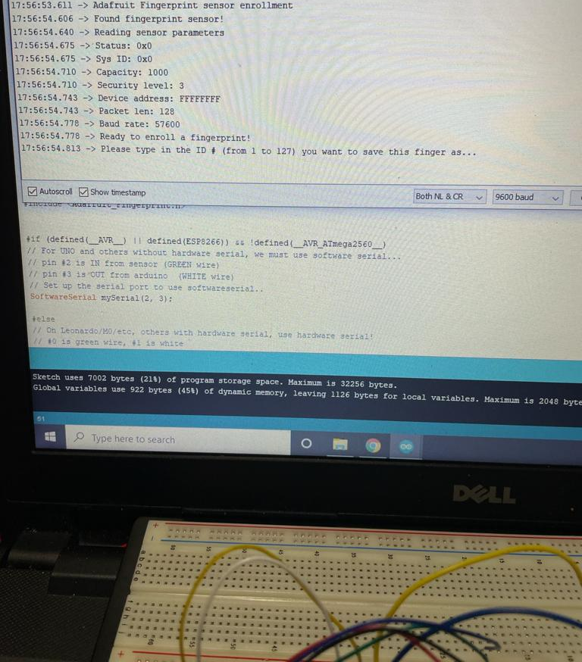
RESULT OF FINGERPRINT SENSOR

Slide 14

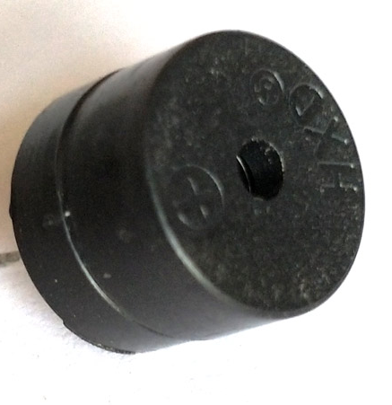
INTRODUCTION TO BUZZER
This buzzer is used to give an alert sound when somebody fails to enter the passcode and fingerprints are not matched.

Slide 15
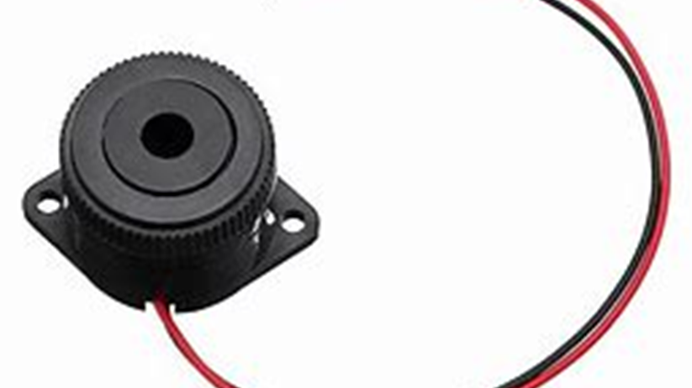
INTRODUCTION TO BUZZER
Buzzer is a kind of electronic sound receiver with integrated structure. It is widely used as a voice device in electronic products like computers, printers, copying machines, alarm apparatus, electronic toys, auto electronic devices, telephones, etc..
Working principle of buzzer: Buzzer has integrated amplify sampling circuit and resonance system, when DC power input passes through active buzzer, it will make resonance device generate sound signal.

Slide 16
SFM-27 ELECTRONIC BUZZER
Rated Voltage: 12V
Operating Voltage: 3-24V
Rated Current(MAX): 20mA
Sound-making Type : Continuous Sound
Sound output : 100dB at 12VDC

Slide 17

COMPONENTS REQUIRED FOR TESTING BUZZER
Arduino UNO
Buzzer
Jumper Wire
Resistor 100ohms
Breadboard

Slide 18
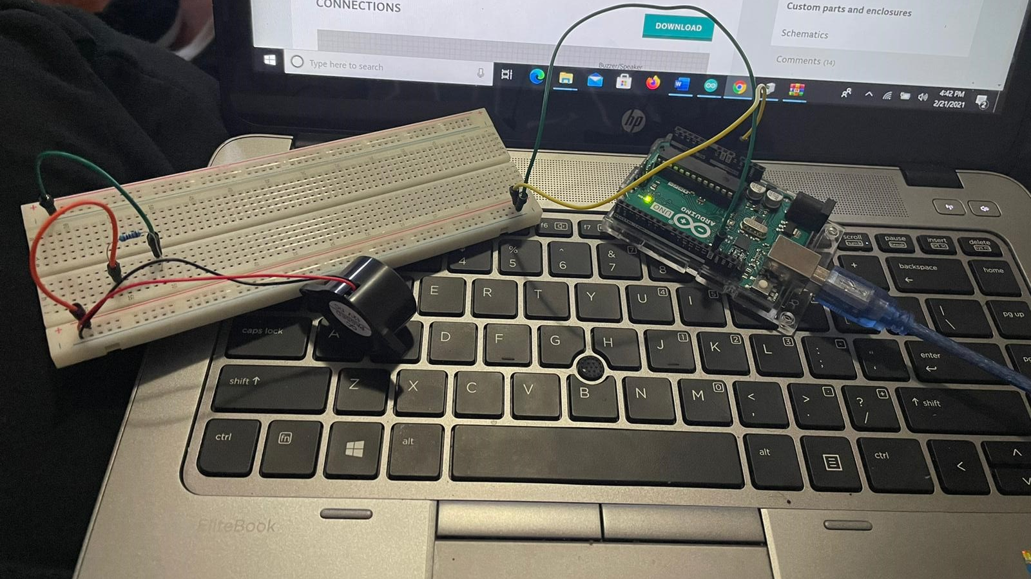
Testing of buzzer using Ardiuno UNO

Slide 19
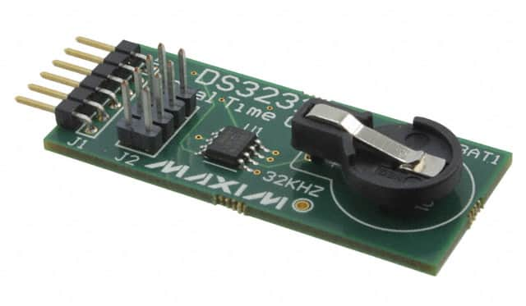
TESTING REAL TIME CLOCK
A real-time clock (RTC) is an electronic device (most often in the form of an integrated circuit) that measures the passage of time. Although the term often refers to the devices in personal computers, servers and embedded systems, RTCs are present in almost any electronic device which needs to keep accurate time.

Slide 20
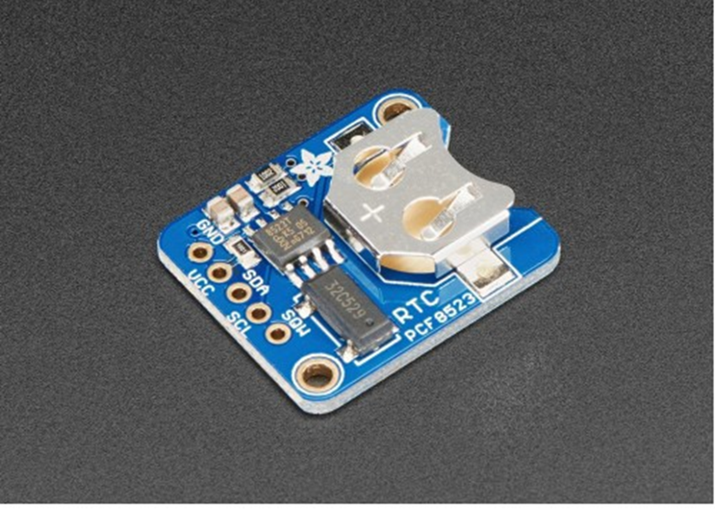
REAL TIME CLOCK
Real time clock (RTC) allows microcontroller project to keep track of time.
We are using RTC for keeping track or real time.

Slide 21
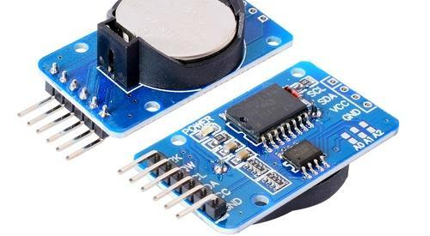
Components used for RTC
Arduino UNO
Male/Female Jumper wires
Real Time Clock Module (DS3231)
Arduino UNO software used run the code.

Slide 22
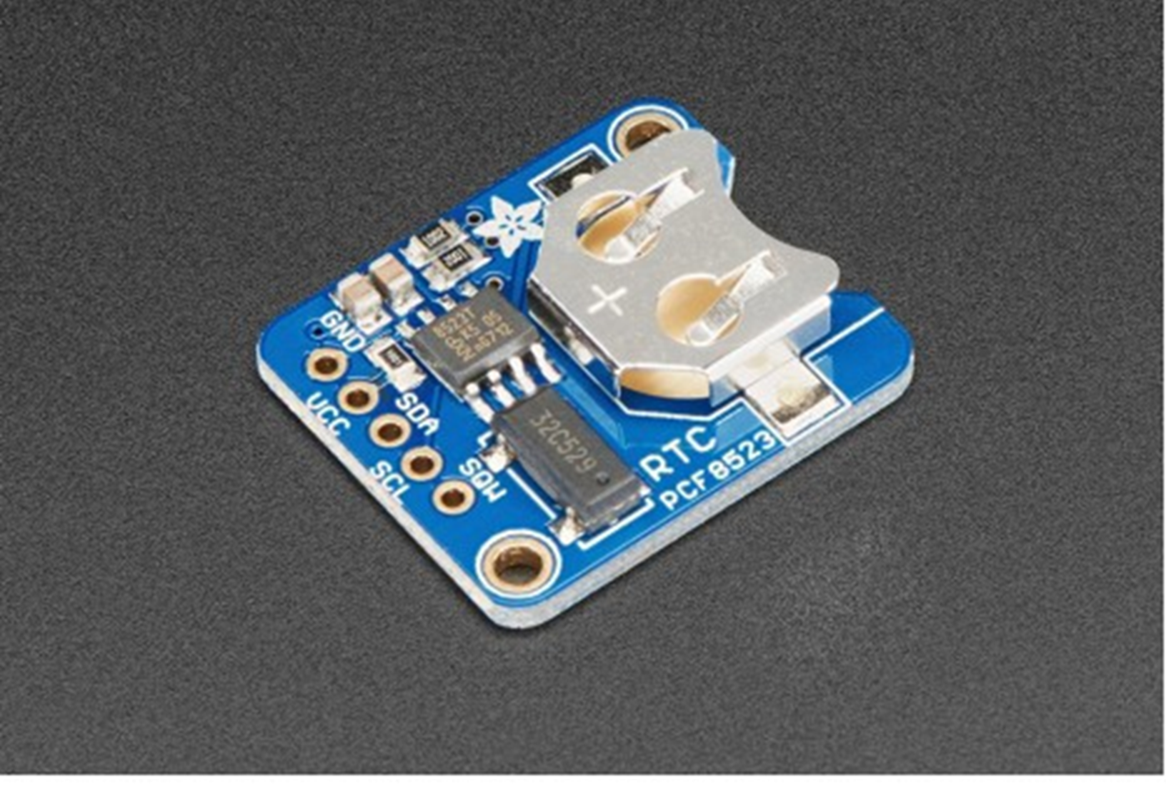
TESTING OF RTC
RTC is connected to Arduino UNO
GND pin connected to GND of Arduino
VCC of RTC connected to 5V of Arduino
SCL of RTC connected to SCL ofArduino
SDA of RTC connected to SCL ofArduino

Slide 23
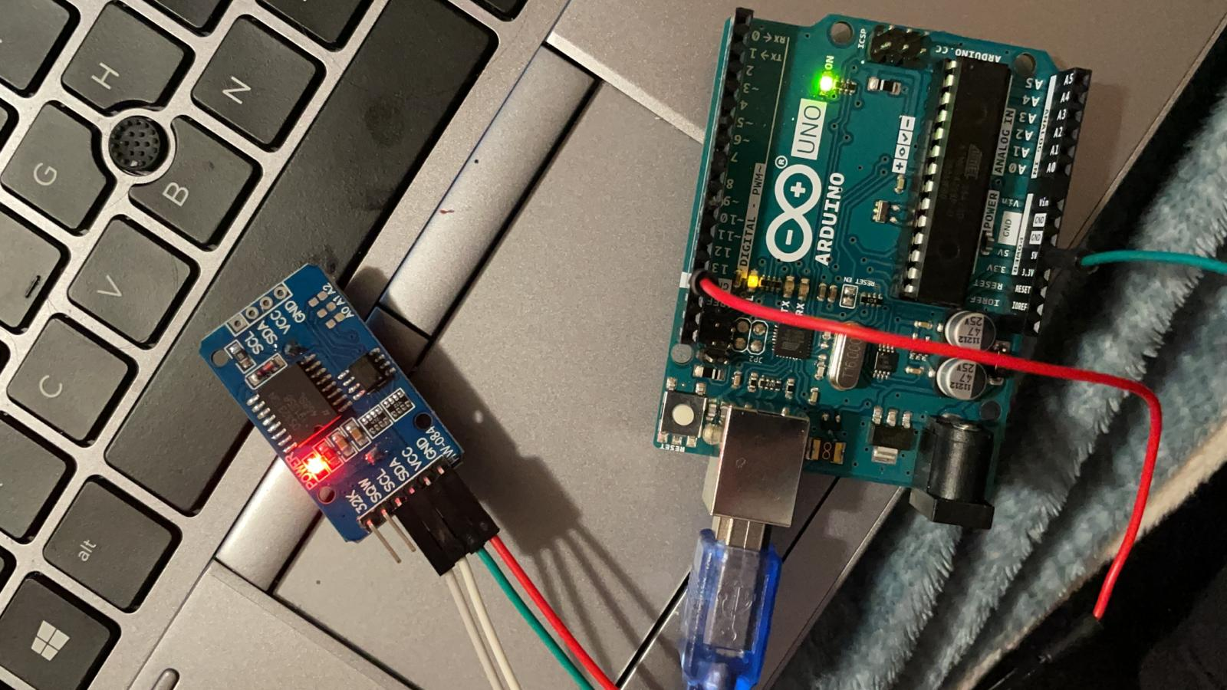
TESTING OF REAL TIME CLOCK

Slide 24
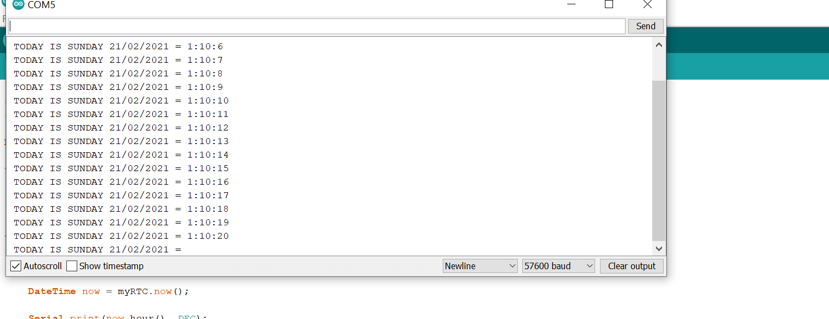
OUTPUT OF RTC

Slide 25
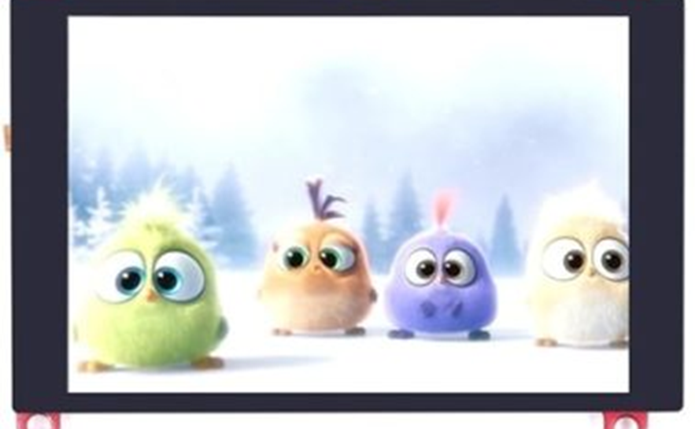
TOUCHSCREEN
3.5-inch screen
Capacitive/Resistive touch control
Supports popular mini-PCs such as Raspberry Pi, BB Black, as well as general desktop computers

Slide 26
TESTING TOUCHSCREEN
TFTs, also called TFT screens, are a type of active-matrix LCD display capable of displaying millions of high-contrast, clear and bright color pixels. TFTs are used in HDTV sets, computer monitors, laptop monitors, tablets, personal media players, smartphones and even feature phones.

Slide 27
Steps to run Touchscreen
Download the test program
Connect the Arduino development board
Copy the dependent library
Compile and download the program to the development board
Observe the running of the program

Slide 28
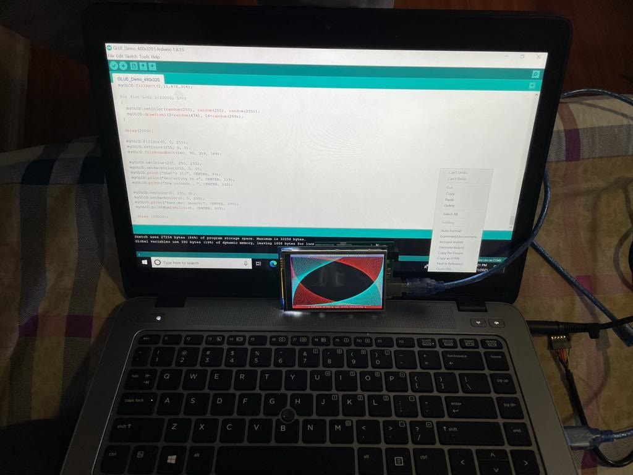
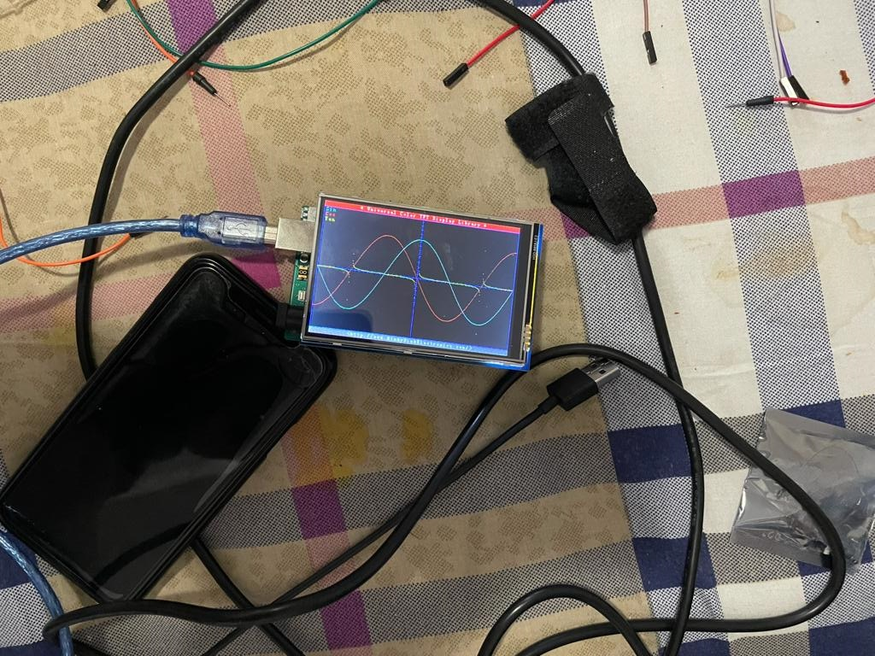
TESTING OF TOUCHSCREEN

Slide 29
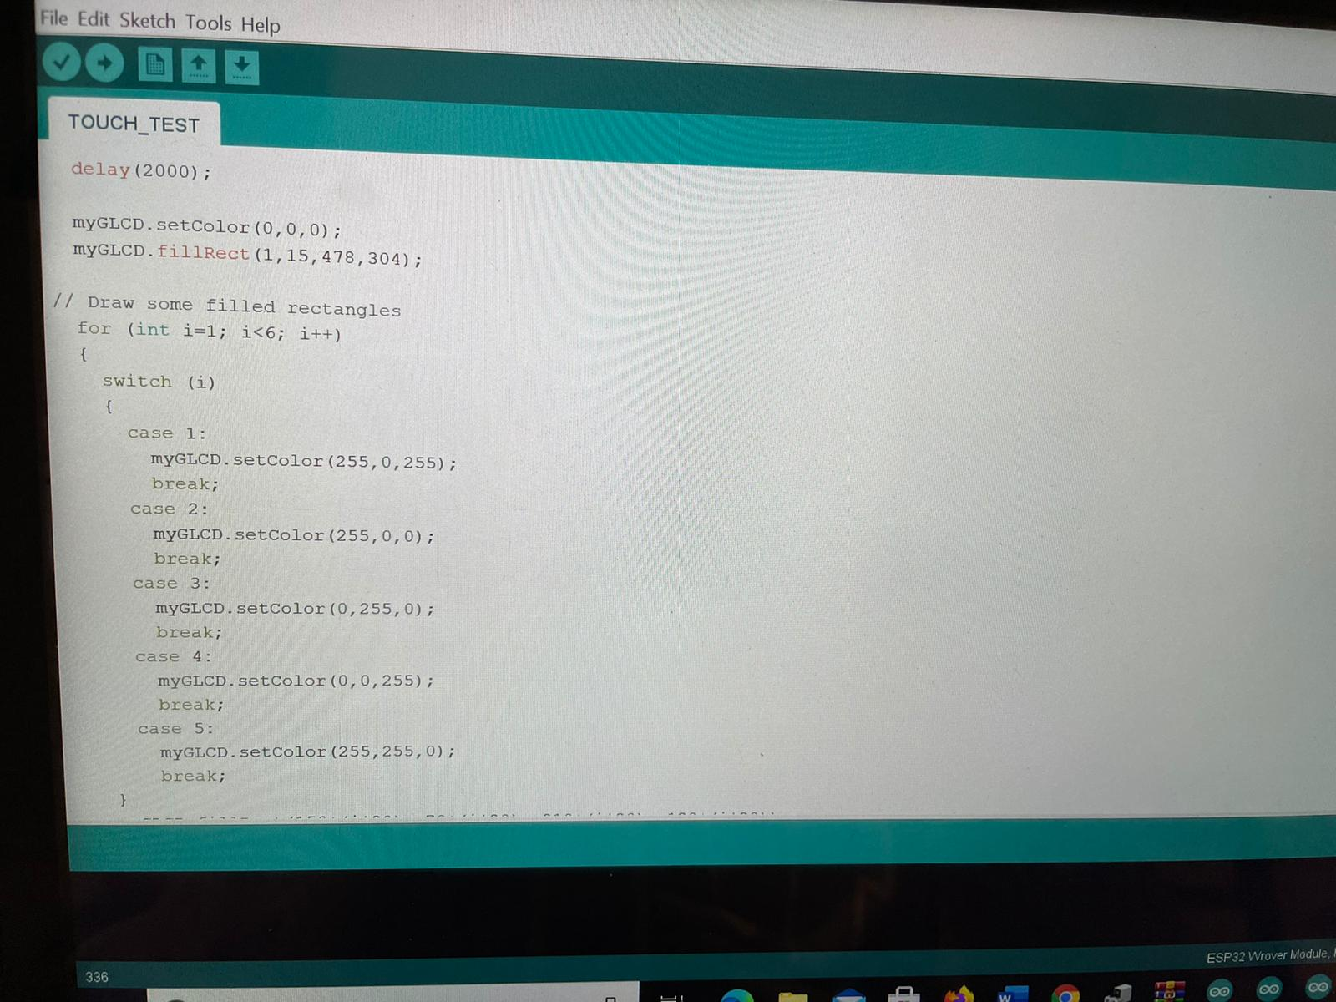
Sample code to turn ON the display using Ardiuno UNO

Slide 30
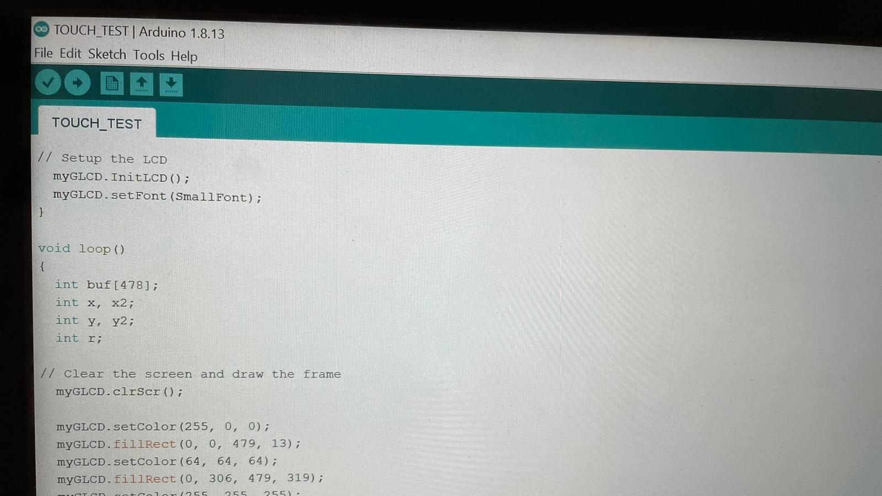
Sample code to turn ON the display using Ardiuno UNO

Slide 31
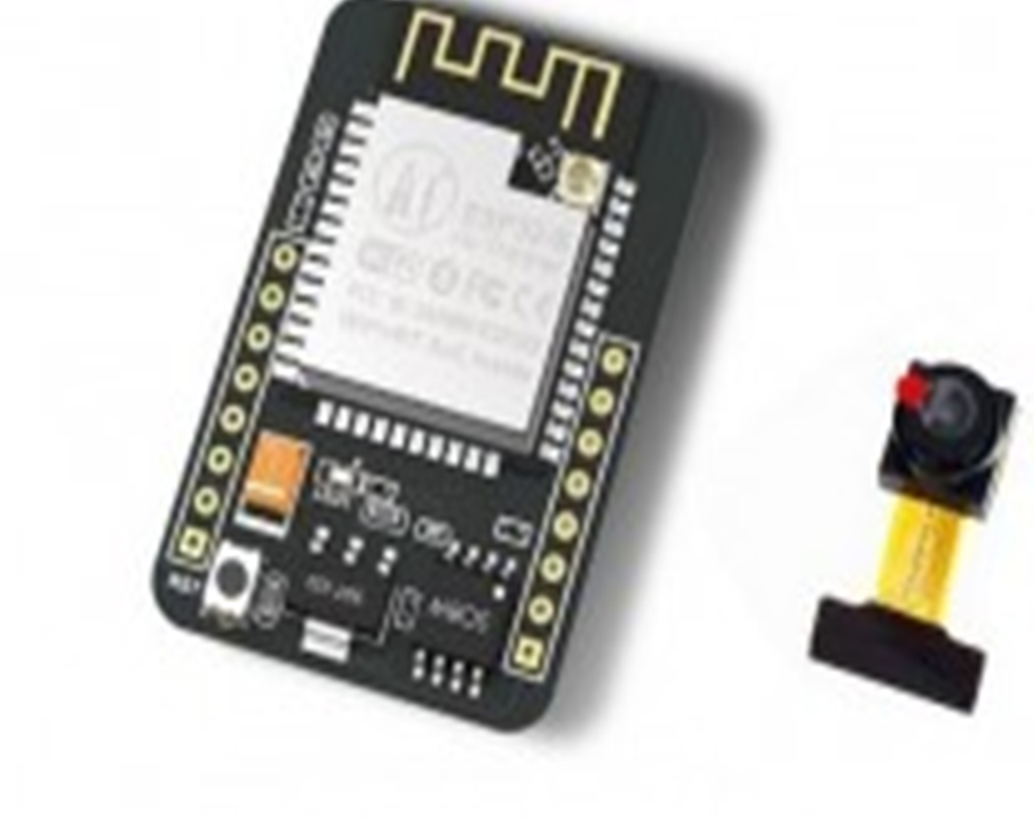
INTRODUCTION TO ESP32
We are making an IoT based project.
So, it requires internet connectivity.
As Beaglebone Black does not have an inbuilt Wi-fi module, we are using and external module.

Slide 32
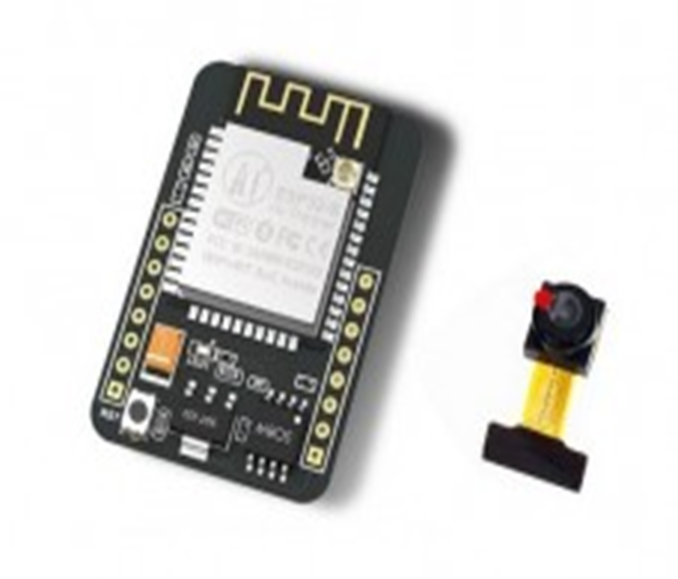
INTRODUCTION TO ESP32 CAM
The ESP32-CAM is a small-sized camera module that can operate independently as a minimum system with a footprint of only 27 x 40 x 4.5mm and a deep sleep current of up to 6mA.
ESP32-CAM adopts a DIP package.
We are using ESP32 CAM Module for taking picture and sending mail.

Slide 33
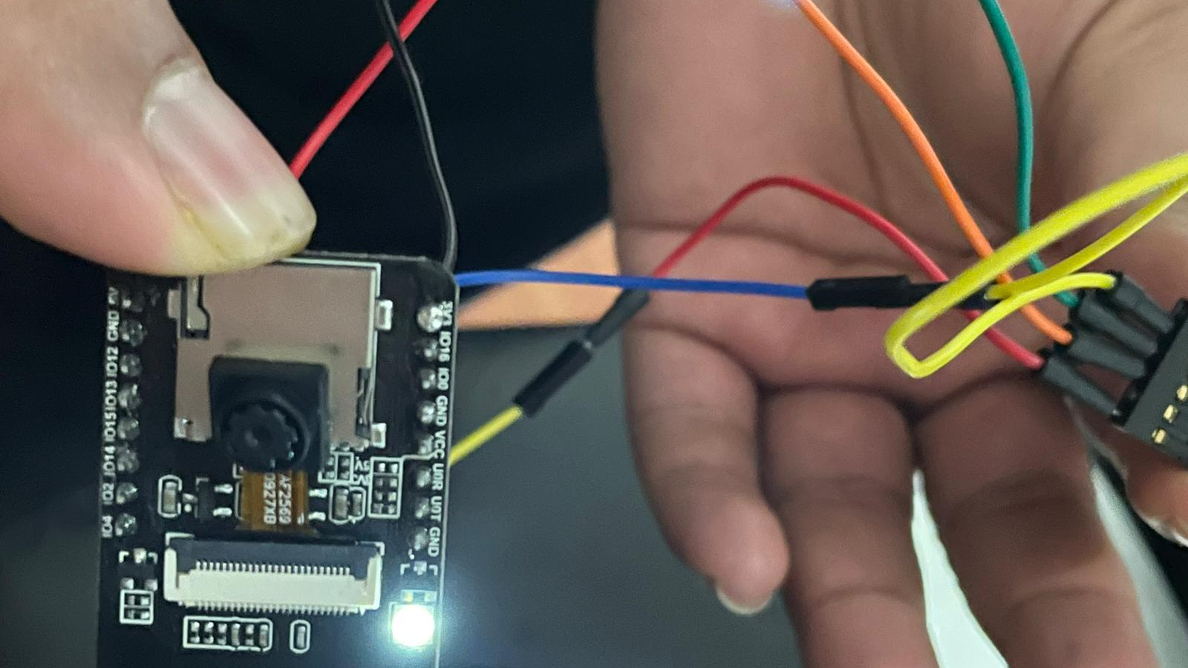
TESTING OF ESP32

Slide 34
REFERENCES
Testing of fingerprint sensor: https://www.vishnumaiea.in/projects/hardware/interfacing-r307-optical-fingerprint-scanner-with-arduino#:~:text=R307%20Pinout%20%20%20Pin%20Number%20%20,Data%20input%20%28TTL%29%20%202%20more%20rows%20
Testing of fingerprint sensor: https://www.youtube.com/watch?v=Bv2k3_oqsmo
Testing of buzzer: https://create.arduino.cc/projecthub/SURYATEJA/use-a-buzzer-module-piezo-speaker-using-arduino-uno-89df45
Testing of RTC: https://create.arduino.cc/projecthub/MisterBotBreak/how-to-use-a-real-time-clock-module-ds3231-bc90fe

Slide 35
REFERENCES
Testing of Touchscreen: http://www.lcdwiki.com/3.5inch_Arduino_Display-UNO
Testing of ESP32 CAM : https://www.youtube.com/watch?v=visj0KE5VtY

